Slide 1
Welcome Presentation on Ecommerce(online shopping)

Slide 2
Group Members
Kaustubh Gawade
Rohan Kulkarni
Srushti Deshmukh

Slide 3
Technology used
Backend Technologies- spring boot
Frontend Technologies- Angular
Languages used-HTML,CSS,JAVA

Slide 4
What is Ecommerce?
Commonly known as electronic Marketing.
It consists of buying and selling goods and services over an electronic systems such as internet and other computer network.

Slide 5
Our system
Our system is an ecommerce website from where people can buy products online.
Admin monitors the activity of the users and check the transactions.

Slide 6
Features
Home Page
Product Details Page
Shipping Address Form
Orders Page
Cart Page

Slide 7
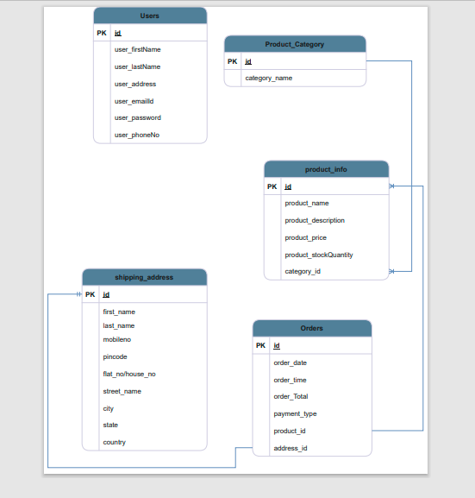
Entity Relationship Diagram

Slide 8
Home page Module
Header – User, Shopping cart, orders, Search products by name on homepage.
All the products which are saved in Database.
We can add product in cart from the home page .
Also, We can go to product details to see its specifications.

Slide 9
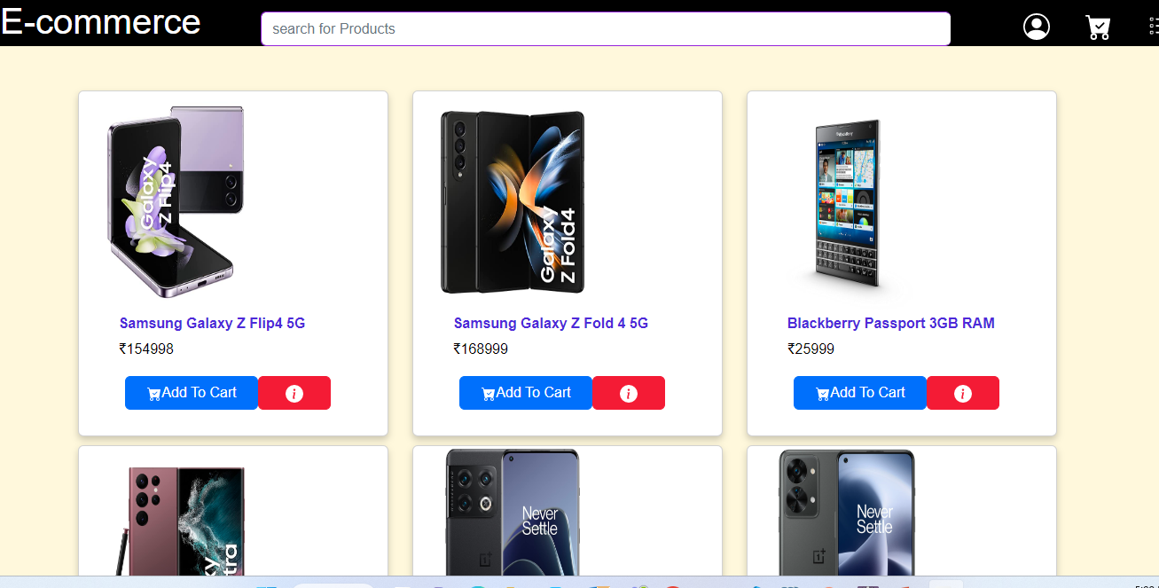
Homepage

Slide 10
Product Details Module
Product name
Product description
Product price
Product image
Product stock quantity

Slide 11
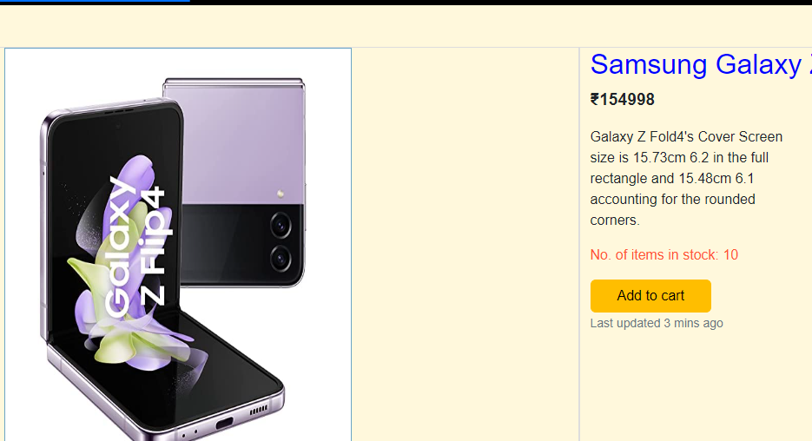
Single Product page

Slide 12
Shopping cart module
Products in users shopping cart
Image
Price
Product quantity
Manipulating products quantity
Adding Shipping address

Slide 13
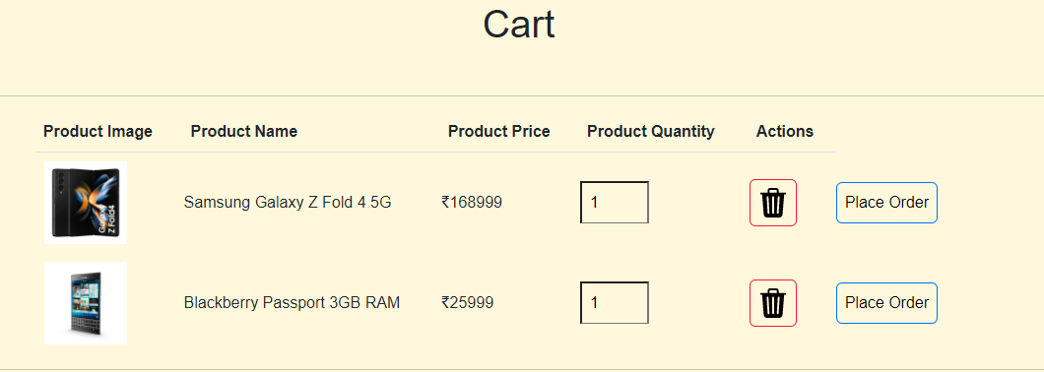
Cart page

Slide 14
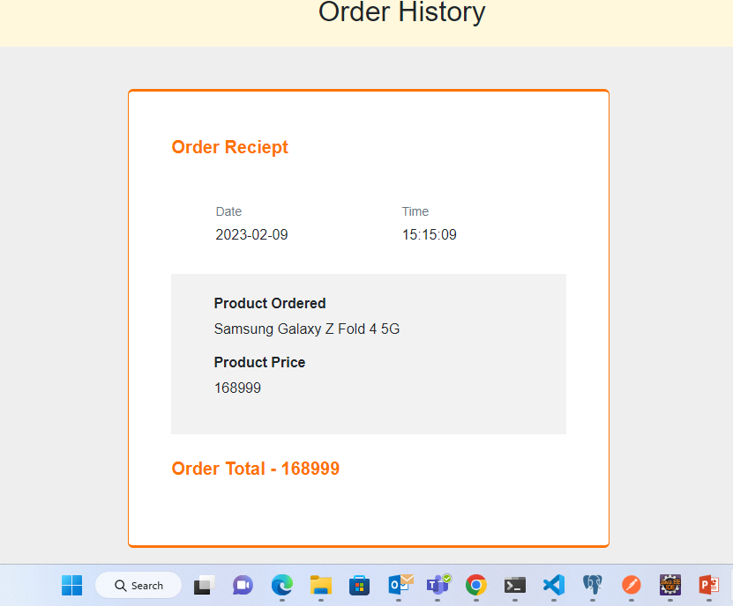
Order History page

Slide 15
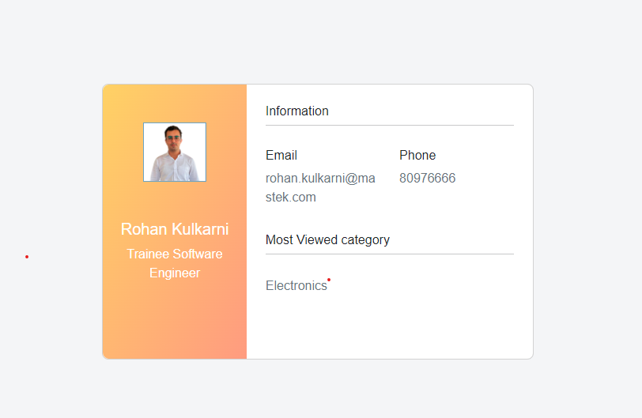
User

Slide 16
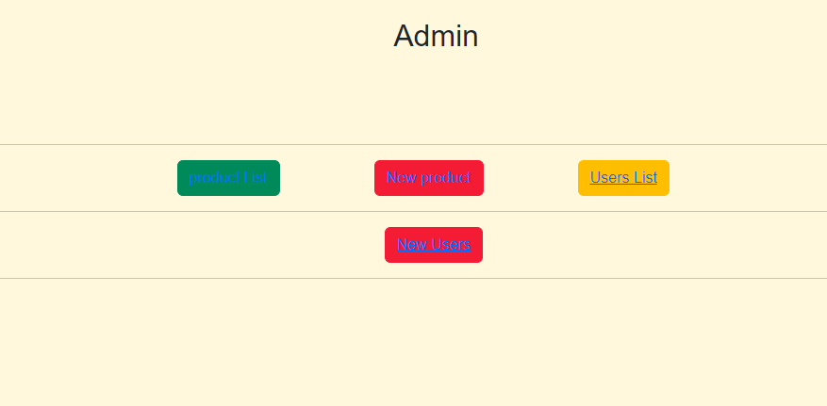
Admin panel

Slide 17
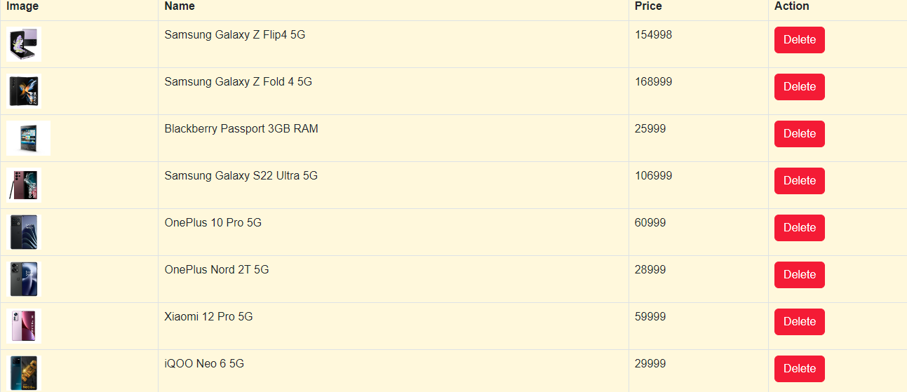
Delete Product As Admin Function

Slide 18
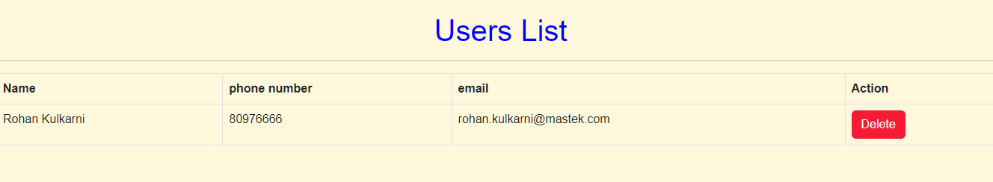
Delete user as admin function

Slide 19
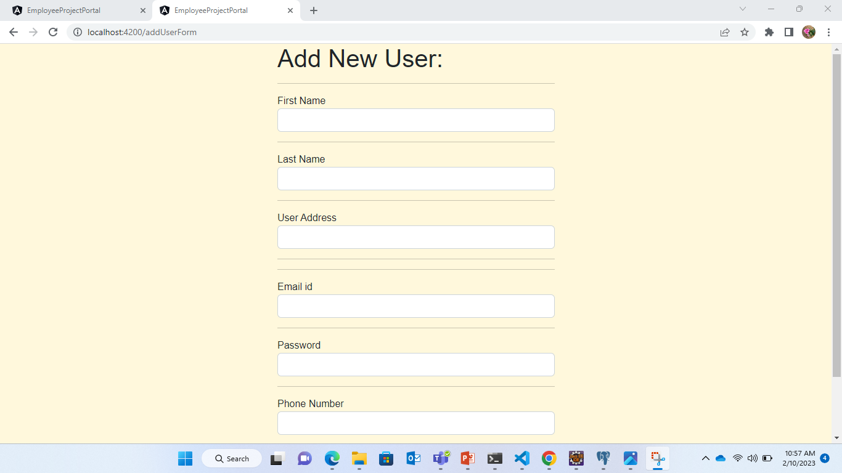
Add new user

Slide 20
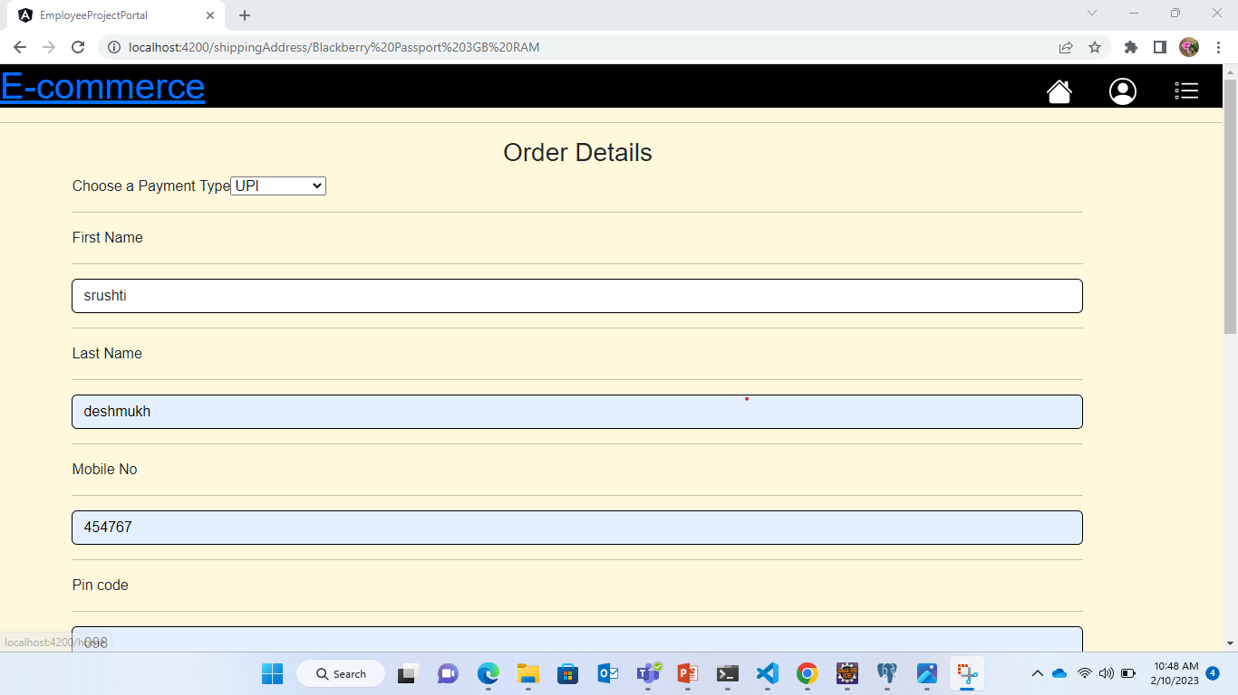
Place Order

Slide 21
Advantages of Ecommerce
Faster buying and selling procedures, as well as easy to find products.
Buying and selling 24/7.
More reach to customers.
Easy to start and manage a business.

Slide 22
Disadvantages of Ecommerce
Unable to examine products personally.
Not everyone is connected to the internet.
There is a possibility of credit card number theft.
Some mechanical failures can cause unpredictable effects on the total process.

Slide 23
Future plan
We are thinking of some modifications and adding some advanced new
features in our system. Some of them are-
GUI modification(more user friendly)
Users can sell their products also
Users can login/signup using their social media accounts such as google, Facebook Instagram etc.

Slide 24
Thank You

